Slide 1


Managing Geospatial Data Using Dataverse + WorldMap
Harvard Datafest
January 18, 2018
Ben Lewis
Harvard Center for Geographic Analysis
Notes:
I’m Ben Lewis with the Harvard center for geographic analysis and today I’m going to talk to you about some simple ways you can use geospatial information within Dataverse by virtue of some integration between Dataverse and a platform called WorldMap that our center manages.

Slide 2
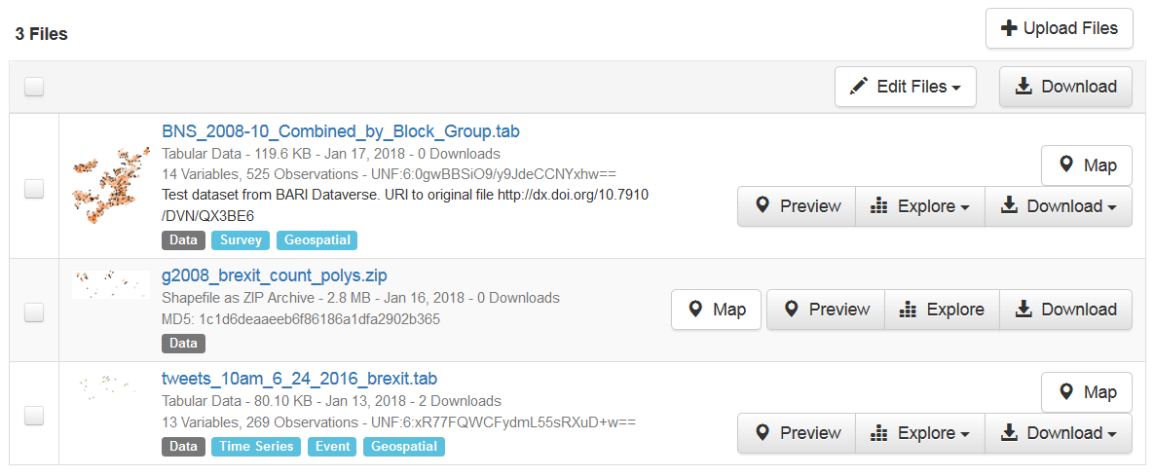
Demo Preparation
Create account in Dataverse http://dataverse.harvard.edu
Create account in WorldMap http://worldmap.harvard.edu
Go to Dataverse: https://goo.gl/kAwVdC
Download the 3 files to your hard drive

Slide 3
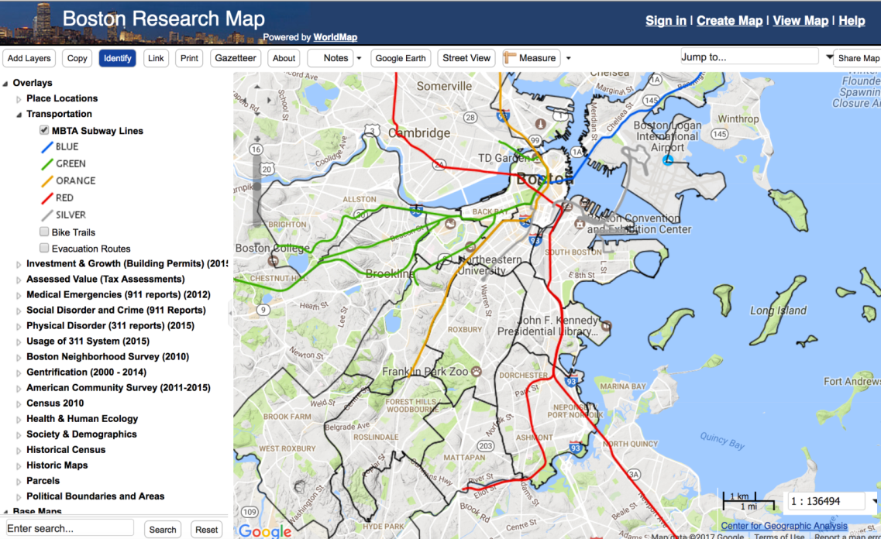


What is WorldMap?
Harvard WorldMap http://worldmap.harvard.edu is an online, open source mapping platform developed to lower barriers for scholars who wish to explore, visualize, edit, and publish geospatial information.

Slide 4
WorldMap
Open to researchers throughout the world
Contains over 25k local map layers and 50k remote services
Created by the Harvard University Center for Geographic Analysis
Hosted on the Massachusetts Open Cloud (MOC)

Slide 5
The need: Boston Area Research Initiative (BARI)
BARI researchers asked the question: Is there an easier way to map our Dataverse files?

Slide 6
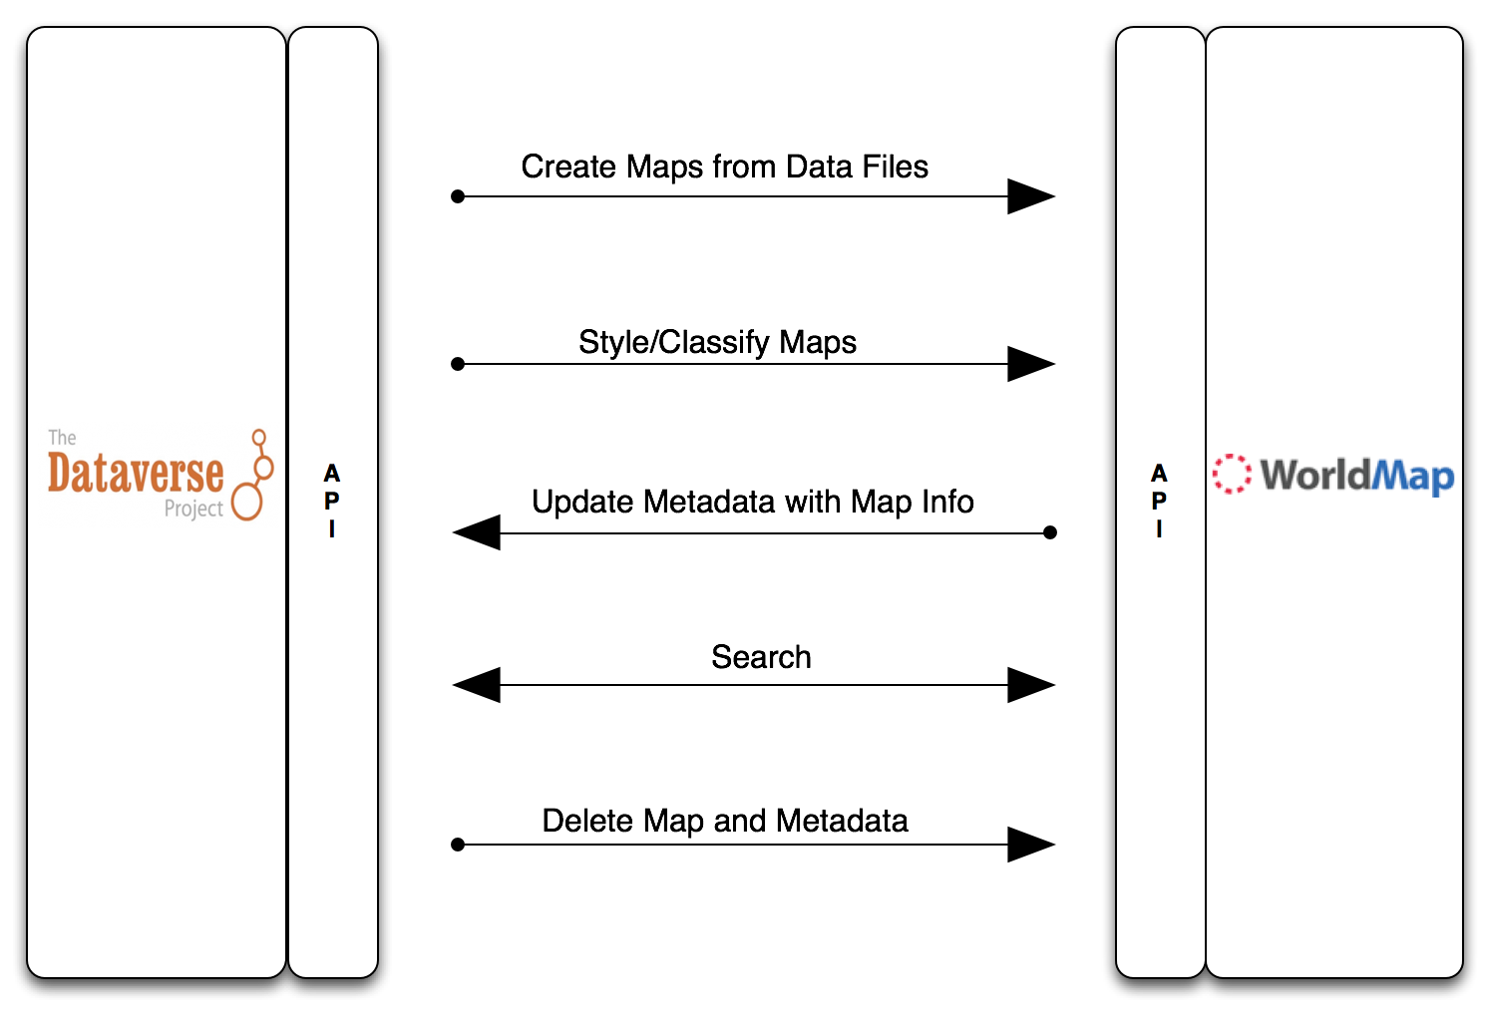
Dataverse / WorldMap Integration
Dataverse and WorldMap have been integrated by adding APIs to both systems.

Slide 7
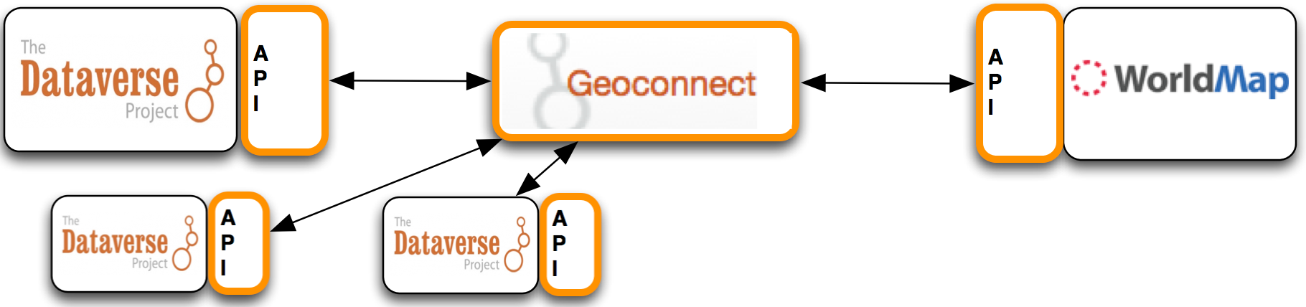
Geoconnect
A small application written in Django (python) called Geoconnect, was built to integrate the API endpoints and facilitate user interaction. This enables multiple Dataverse installations to connect to Geoconnect and use WorldMap.

Slide 8
WorldMap / Dataverse Demos
Three types of Dataverse file:
Tables with columns containing latitude and longitude
Files of type “shapefile”, zip compressed.
Tables with a column of known codes which represent geometries, i.e. Zip, Census, FIPs, etc.
For each of the 3 types one can:
Create data-driven map symbolization options
Obtain downloads in variety of spatial formats
Overlay with other map layers in WorldMap
Notes:
So we’ve developed an API which allows Dataverse to connect to WorldMap and send data to it to be mapped. Some information is also sent back to dataverse from worldmap to support the presentation of maps inside the dataverse page. Data mapped in Dataverse this way involves making a public copy of the data in WorldMap. So clearly this makes sense with data that can be made public. At least for now.

Slide 9
1) Lat/Long Demo
The data to be used comes from CGA’s Geo-tweet archive
Geo-tweets are tweets which contain a GPS coordinate from the originating device.
The CGA harvests about 1 million per day and has been harvesting them since October of 2012.
The archive is currently stored offline and is available for researchers upon request.

Slide 10
(1) Background on Lat / Long Table Provided
Started with 1 hour CSV file from the Geo-tweet Archive (250,000 records).
Time range is one hour, from 10-11am on June 24th, 2016 the day after the British decision to leave the EU (Brexit).
Tweet records mentioning Brexit were extracted and resulting CSV file uploaded to Dataverse.

Slide 11
Structure of the geo-tweet CSV file
tweet_id ID from twitter
time Time stamp from twitter
Lat Latitude of device from twitter
Lon Longitude of device from twitter
goog_x Spherical mercator X coordinate from CGA
goog_y Spherical mercatpr Y coordinate from CGA
sender_id ID of sender from twitter
sender_nam Sender name from twitter
source Type of application use to create tweet
reply_to_u
reply_to_t
place_id Place ID from twitter
tweet_text Tweet text
Notes:
If you request data from us we can extract but must provide the IDs only. You can rehydrate.

Slide 12
Demo

Slide 13
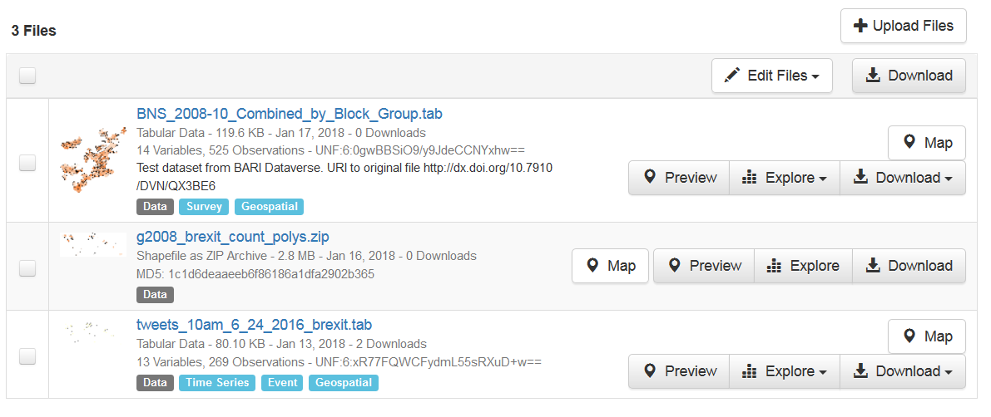
Lat / Long Table
1) Download the geo-tweet file from
https://goo.gl/kAwVdC
2) Upload the file to your Dataverse

Slide 14
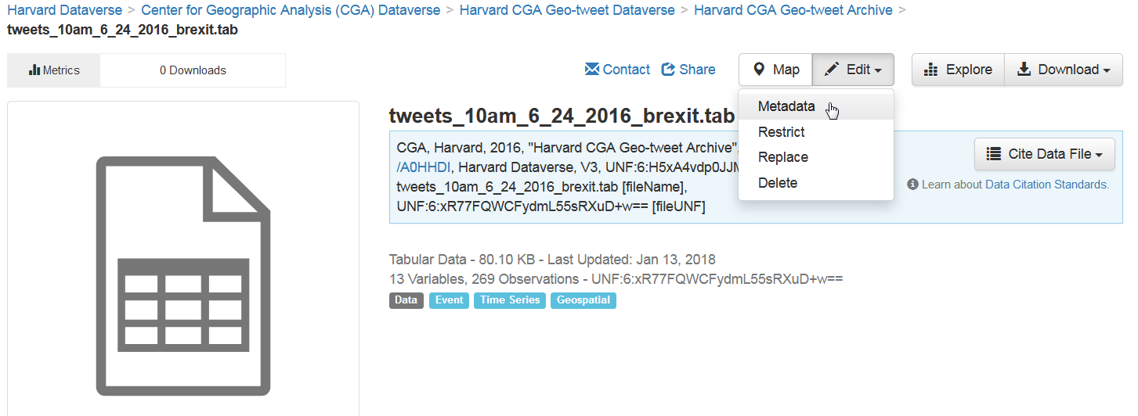
In Dataverse give the file a tag for “data”
Open file and edit metadata

Slide 15
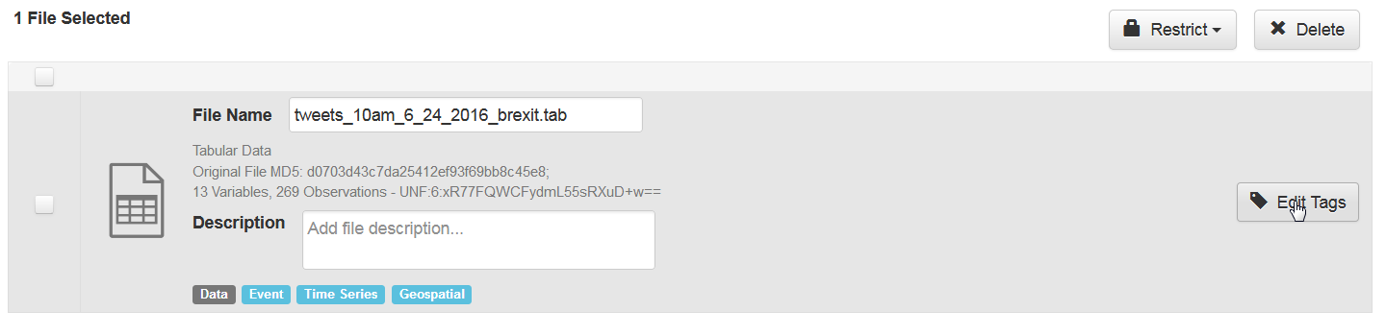
Tell Dataverse the file is geospatial
1) Edit tags

Slide 16
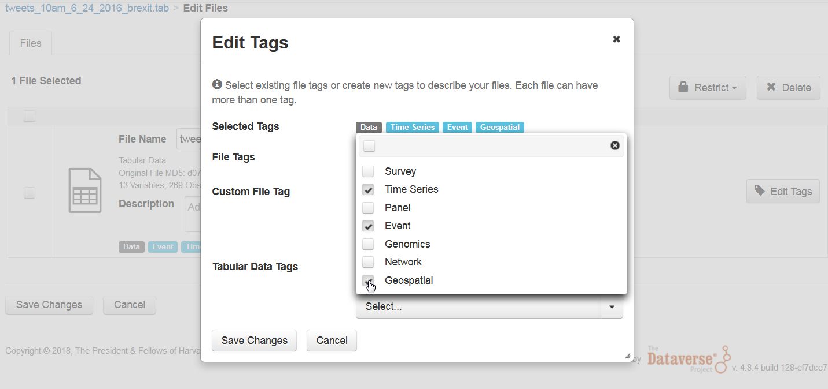
Tell Dataverse the file is geospatial
2) Select “Geospatial” and any others from “Tabular Data Tags”

Slide 17
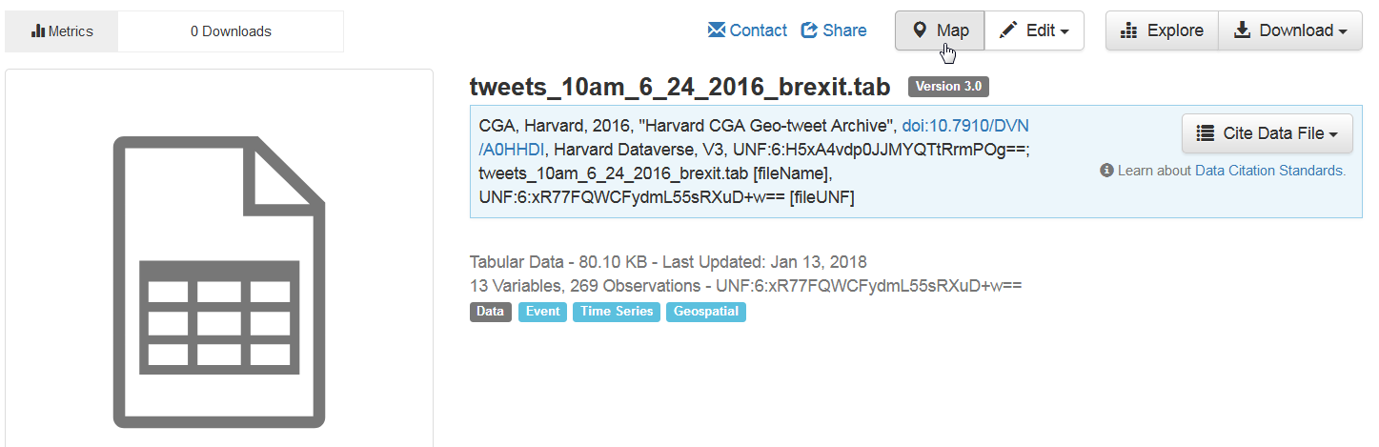
Tell Dataverse the file is geospatial
3) Save Changes. A “Map” button becomes available for the dataset

Slide 18
“Explore” button with Two Ravens

Slide 19
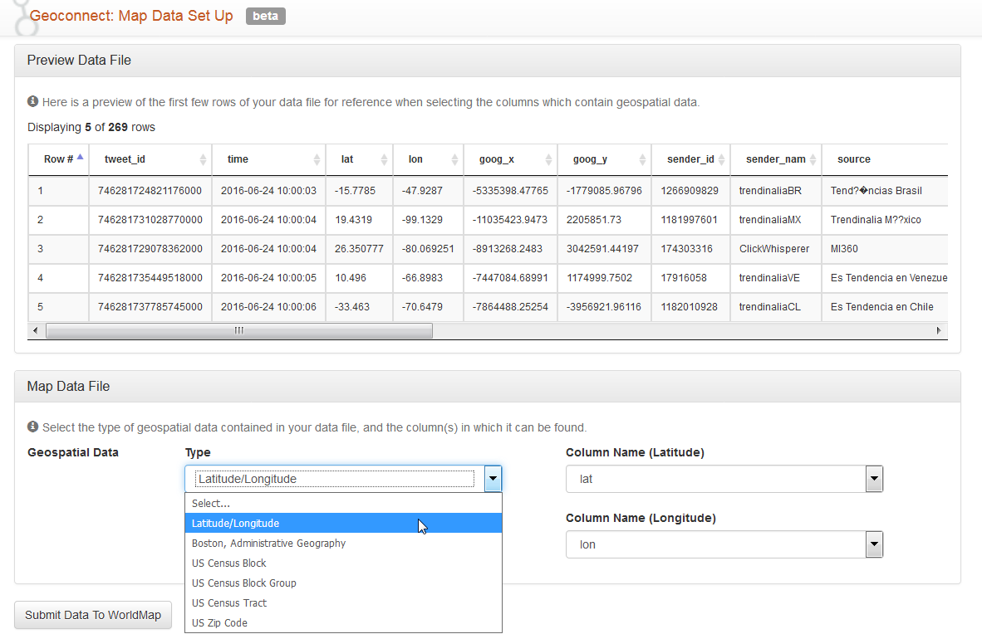
Click “Map” button to view sample data structure and set the geospatial type and fields for lat and long

Slide 20
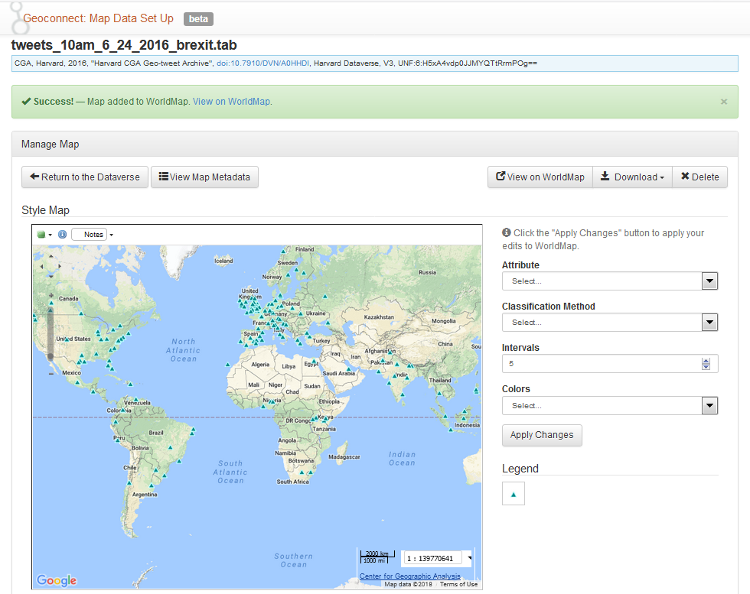
Which brings you to the “Manage Map” Page

Slide 21
Features of Manage Map Page
Interactive view: layer on/off, change base, pan, zoom, identify, show notes
Download formats: KML, PDF, ZIP, CSV, PNG, TIFF, JPG, XLS, GML, JSON
Symbolization
Go to WorldMap page for Layer where there are additional options inside Worldmap

Slide 22
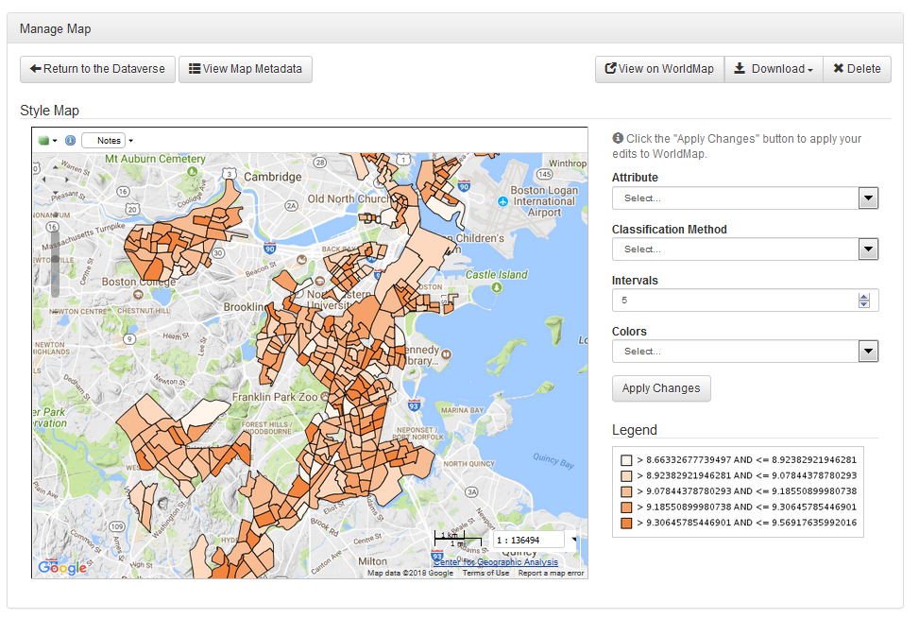
1) Interactive view

Slide 23
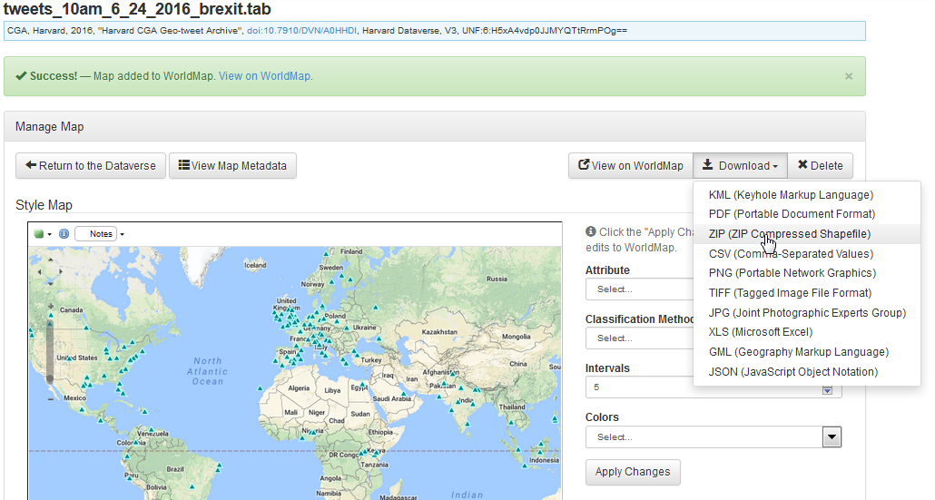
2) Download formats

Slide 24
2) Downloadable formats (spatial formats in bold)
KML – Keyhole Markup Language used in Google Earth and other system.
PDF – Portable Document Format.
ZIP - Zip-compressed Shapefile. Shapefile is the most common vector GIS data format.
CSV – Comma separated table
PNG – Portable Network Graphics
TIFF - Tagged Image File Format
JPEG – Joint Photographic Experts Group
XLS – Excel spreadsheet
GML – Geographic Markup Language
GeoJSON – JavaScript Object Notation

Slide 25
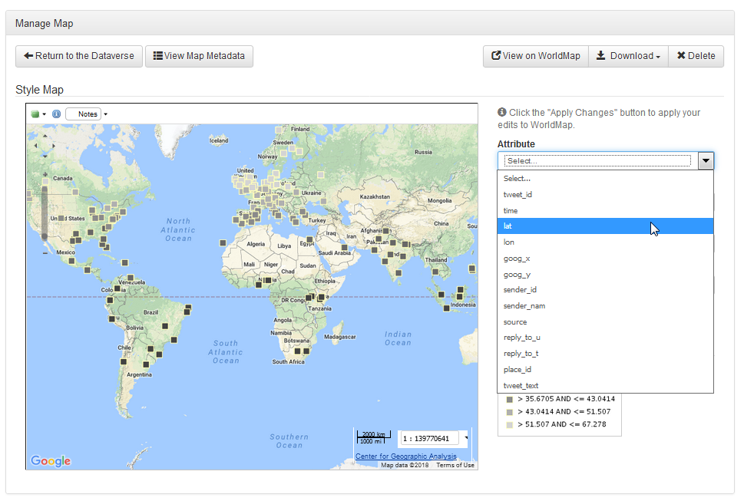
3) Symbolize map
1. Choose an attribute.
Notes:
Numeric attributes support binning. Text support grouping by arbitrary colors.

Slide 26
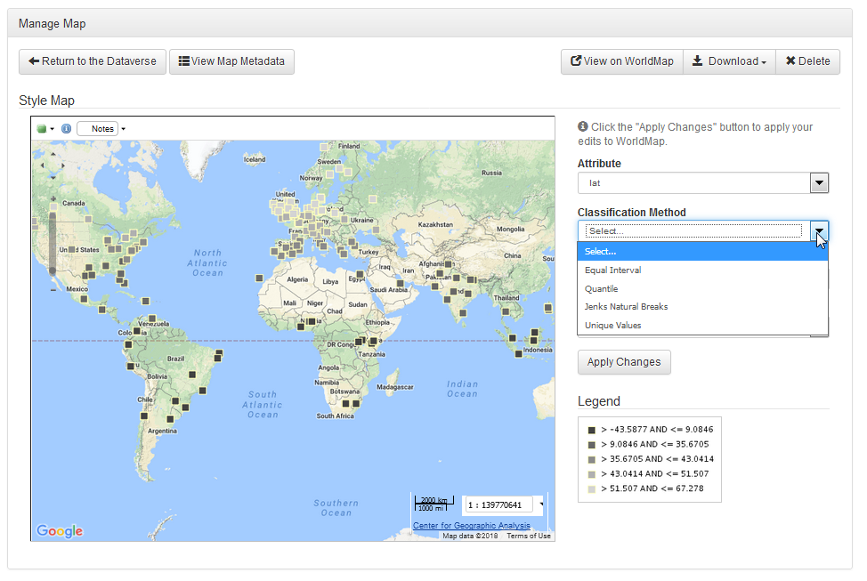
Symbolize map
2. Choose classification method

Slide 27
Map data classification methods:
Equal Interval
Equal interval divides the range of attribute values into equal-sized subranges. Equal interval is best applied to familiar data ranges, such as percentages and temperature.
Quantile
Each class contains an equal number of features. A quantile classification is well suited to linearly distributed data. Quantile assigns the same number of data values to each class.
Jenks Natural Breaks
The Jenks optimization method, also called the Jenks natural breaks classification method, is a data clustering method designed to determine the best arrangement of values into different classes. This is done by seeking to minimize each class’s average deviation from the class mean, while maximizing each class’s deviation from the means of the other groups. In other words, the method seeks to reduce the variance within classes and maximize the variance between classes. https://en.wikipedia.org/wiki/Jenks_natural_breaks_optimization.
Unique Values
Unique values symbolize qualitative categories of values.

Slide 28
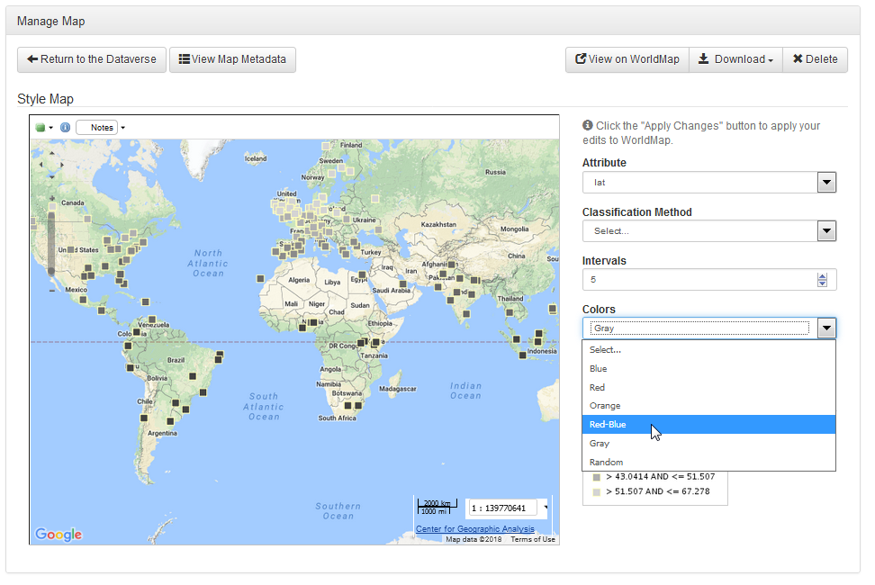
Symbolizing the map
3. Choose number of intervals and color range

Slide 29
Interval (Binning) Considerations
If you want your legend to be readable with one color (i.e. shades of red) don’t choose more than 5 or 6 intervals.
If you use multiple colors such as the “blue-to-red” option you can likely use 10 or 12 intervals and maintain readibility.

Slide 30
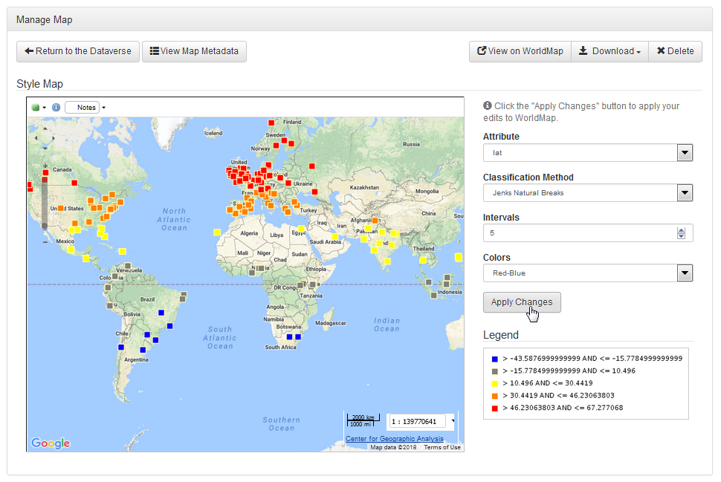
Symbolizing the map
4. Apply changes

Slide 31
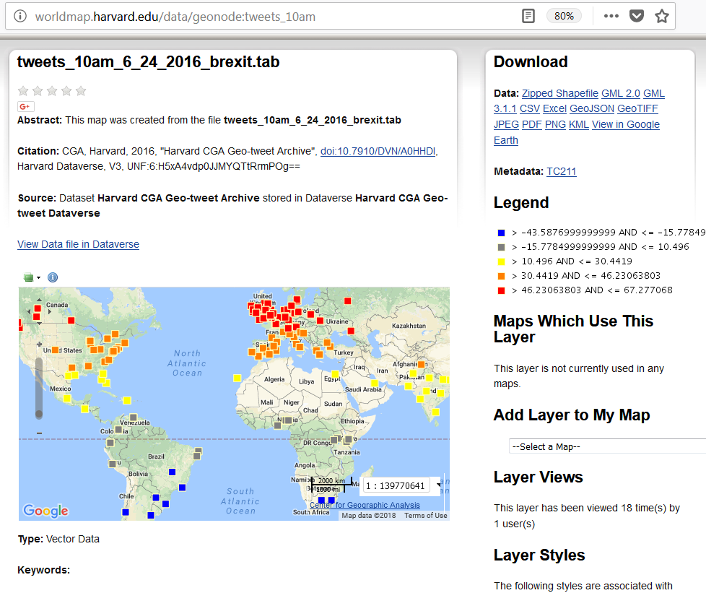
Symbolizing the map
5. Go to WorldMap page for layer

Slide 32
WorldMap Page for Layer
Additional capabilities:
Add to WorldMap Map
Get OGC WMS link for adding layer as a service to other systems
Once you add to Map, many new capabilities including:
Overlay with thousands of other layers
Upload of rasters
Eidting of layers uploaded to WorldMap (you can’t edit layers loaded from Dataverse because Dataverse owns them)

Slide 33
Zipped Shapefiles
1) Download the zipped shapefile from
https://goo.gl/kAwVdC
2) Upload the file to your Dataverse

Slide 34
Zipped Shapefile
Same tagging steps as for Lat/Long table
Edit Metadata to add “Data” tag
“Add + Metadata” button to add geospatial tag.
“Map” button appears

Slide 35
Tables with Column Containing Known Geospatial Codes
1) Download the “BNS_2008…tab” file from
https://goo.gl/kAwVdC
2) Upload the file to your Dataverse

Slide 36
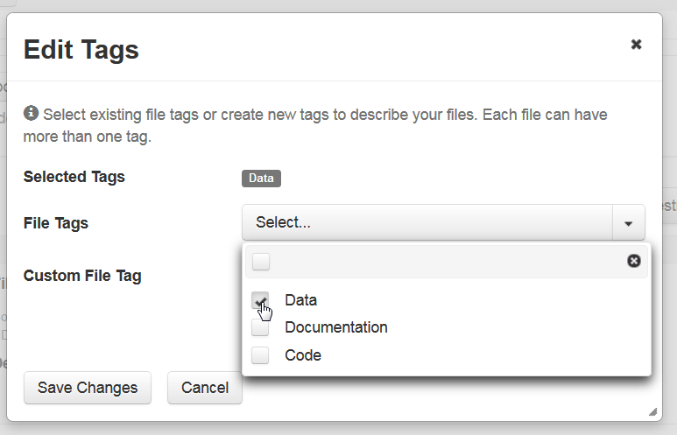
Upload “BNS_2008…” file
Edit tags to add “Data” tag
Save changes
Go into file
Add + Edit Metadata
Edit tags

Slide 37
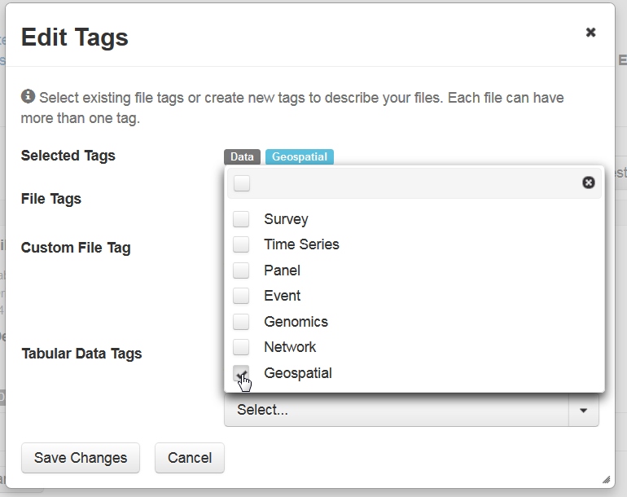
Add geospatial tag
Save changes
“Map” button appears. Must first publish your Dataverse.

Slide 38
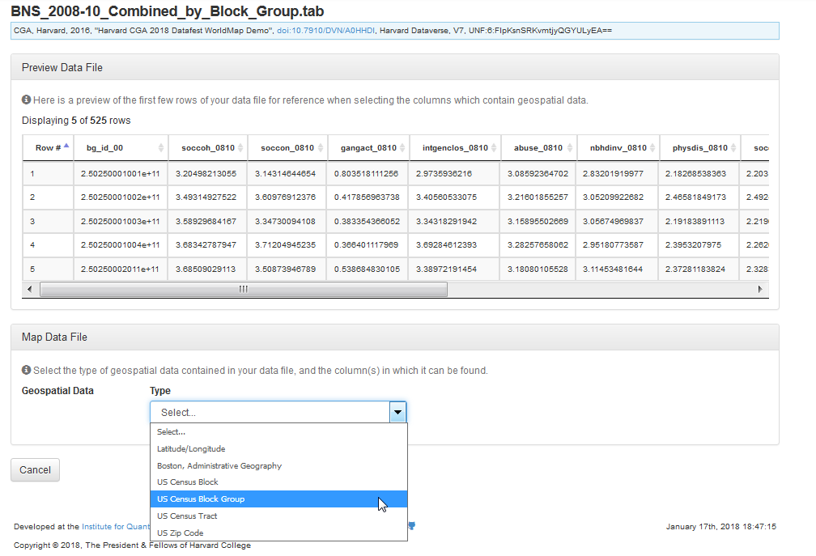
See data structure
For Geospatial Data type, choose
“US Census Block Group”

Slide 39
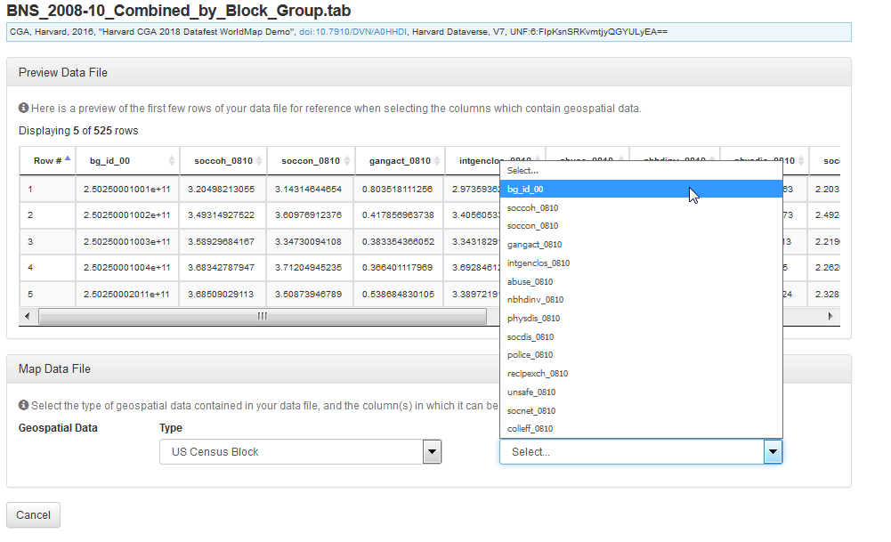
Choose column name bg_id_00

Slide 40
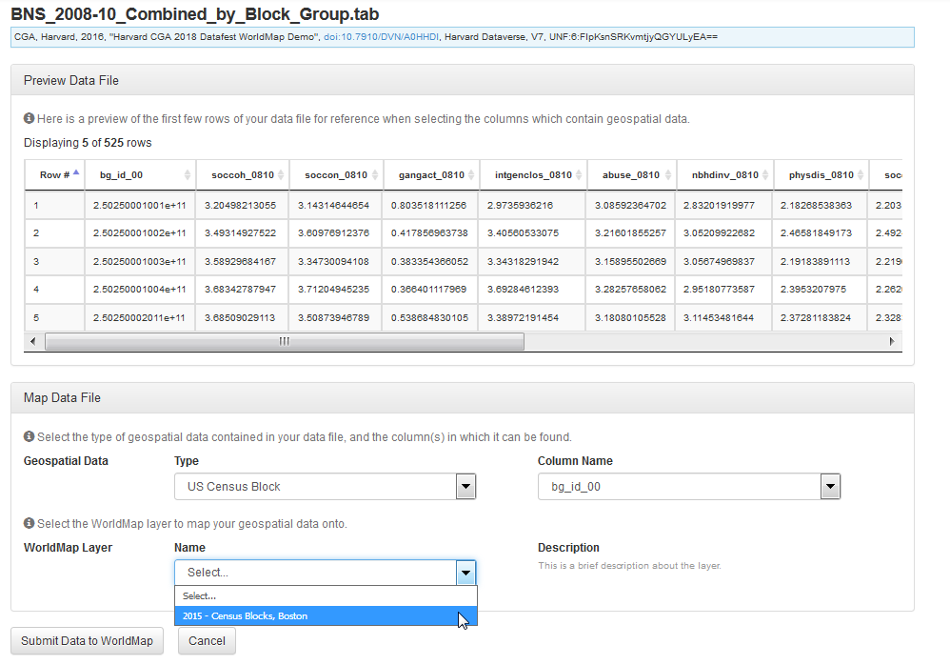
Choose WorldMap layer “2015 Census Block Groups, Boston” then click “Submit Data to WorldMap”

Slide 41
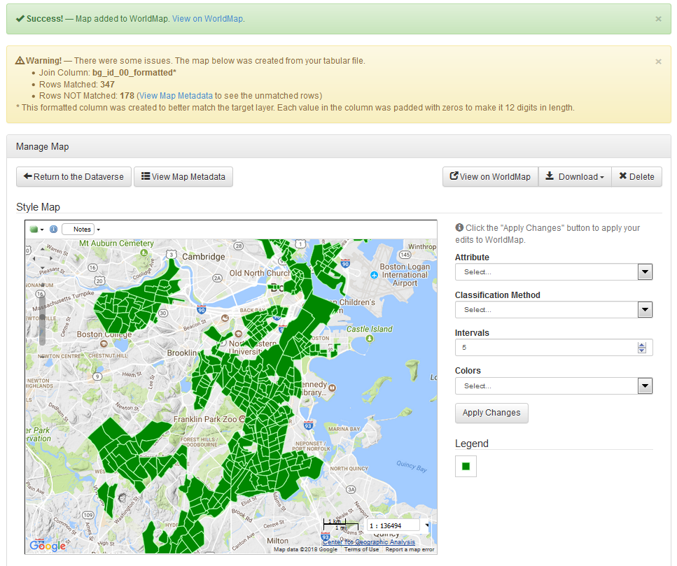
Manage Map Page
See report on what matched
The rest is same as
other data types.

Slide 42
Variables to map in BNS_2008-10_Combined_by_Block_Group.tab
soccoh (Social Cohesion), or the strength of positive social relationships between people in the neighborhood
soccon (Social Control), or the perceived ability of the neighborhood to enforce shared norms
gangact (Gang Activity), or the perceived level of gang activity in the neighborhood
IntgenClos (Intergenerational Closure), or the extent to which unrelated adults and children in the neighborhood have positive relationships
Abuse, or the perceived likelihood that domestic abuse would be reported in this neighborhood
NbhdInv (Neighborhood Involvement), or the participation and awareness with respect to neighborhood activities
PhysDis (Physical Disorder), or the perceived degree of physical disorder issues. Note: Higher scores indicate less physical disorder.
SocDis (Social Disorder), or the perceived degree of social disorder issues. Note: Higher scores indicate less physical disorder.
Police, or the perceived success of police activities in the neighborhood
RecipExch (Reciprocal Exchange), or the perceived degree to which neighbors interact with one another in the neighborhood
Unsafe, or the fear of crime in the neighborhood
SocNet (Social Network), or the size of the social networks of neighborhood residents
CollEff (Collective Efficacy), or a neighborhood’s capacity to accomplish shared goals, is the mean of the neighborhood’s measured social cohesion (soccon) and social control (soccon).
Reference:
Author: Injury Control Research Center and Boston Area Research Initiative
Publisher: Harvard Dataverse
Title: Boston Neighborhood Survey: Neighborhood-Level Metrics
Year: 2017
Doi: 10.7910/DVN/QX3BE6
url: http://dx.doi.org/10.7910/DVN/QX3BE6

Slide 43
Useful links
WorldMap Block Group Layer for Boston
http://worldmap.harvard.edu/data/geonode:census_block_groups_2010_boston_bari_alv
BARI Neighborhood Survey Dataverse
https://dataverse.harvard.edu/dataverse/BostonNeighborhoodSurvey
Source URI for BNS_2008-10_Combined_by_Block_Group.tab
http://dx.doi.org/10.7910/DVN/QX3BE6

Slide 44
Source code
Billion Object Platform (system for visualizing geo-tweets)
https://github.com/cga-harvard/hhypermap-bop
Tweet rehydration
https://github.com/cga-harvard/hhypermap-bop/tree/master/BOP-utilities/Twitter_Rehydration
Tweet sentiment classifier
https://github.com/cga-harvard/hhypermap-bop/tree/master/Twitter-Sentiment-Classifier

Slide 45
Special thanks to
Gary King, Dan O’Brien, Robert Sampson, Chris Winship, Raman Prasad, Paolo Corti, Merce Crosas, Gustavo Durand, Wendy Guan, the Dataverse Team and The Radcliffe Institute.

Slide 46
Also wanted to mention a new platform…
We are stating to use an open source big data geospatial analytics platform called MapD.
It is a GPU database which supports visualization and analytics against billions of records.
https://www.mapd.com/blog/2017/08/16/rejoining-forces-a-new-old-partnership-with-the-harvard-center-for-geographic-analysis/amp/
https://www.mapd.com/demos/

Slide 47
Thank you
blewis@cga.harvard.edu

